Slide 1
DATA ENTRY AND PREPARATION
TYBSC IT SEM VI
PROF. ARTI GAVAS
ANNA LEELA COLLEGE OF COMMERCE AND ECONOMICS,
SHOBHA JAYARAM SHETTY COLLGE FOR BMS, KURLA
UNIT III, CHAPTER-II

Slide 2
SPATIAL DATA INPUT
Spatial data can be obtained from various sources.
It can be collected from scratch, using direct spatial acquisition techniques or indirectly by making use of existing spatial data collected by others.
Direct Spatial Data Capture
Indirect Spatial Data Capture
There are different methodologies to capture data, but we could make a first big division, depending on the fact that we use preexisting data as the origin of our own data, or if we are going to create data basically from scratch.
It is very important that the GIS analyst has a clear idea of what the project intends to analyze, because depending on the purpose of the study, one system or another could be the most appropriate at that moment.

Slide 3
SPATIAL DATA INPUT
Direct Spatial Data Capture
Primary geographic data capture
Captured directly from environment
Main concern is to know its properties, parameters of any geographic process
Indirect Spatial Data Capture
Secondary geographic data capture
Derived from existing paper maps through scanning or digitization
Processed data purchased from agencies etc.

Slide 4
Indirect Spatial Data Capture
  Digitizing
  Scanning
  Vectorization

Slide 5

Digitizing
Digitizing in GIS is the process of converting geographic data either from a hardcopy or a scanned image into vector data by tracing the features.
During the digitizing process, features from the traced map or image are captured as coordinates in either point, line, or polygon format.

Slide 6

Scanning
Scanning converts paper maps into digital format by capturing features as individual cells, or pixels, producing an automated image.
Maps are generally considered the backbone of any GIS activity. But many a time paper maps are not easily available in a form that can be readily used by the computers.
Most of the paper maps had been prepared on the basis of old conventional surveys.
New maps can be produced using improved technologies but this requires time as it increases the volume of work.
Thus, we have to resort to the available maps. These paper maps have to be first converted into a digital format usable by the computer.
The technology used for this kind of conversions is known as scanning and the instrument used for this kind of operation is known as a scanner.
A scanner can be thought of as an electronic input device that converts analog information of a document like a map, photograph or an overlay into a digital format that can be used by the computer.
Scanning automatically captures map features, text, and symbols as individual cells, or pixels, and produces an automated image.

Slide 7
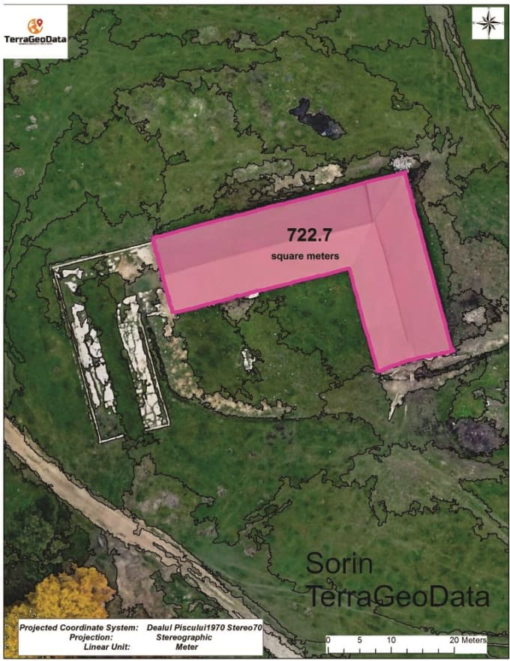
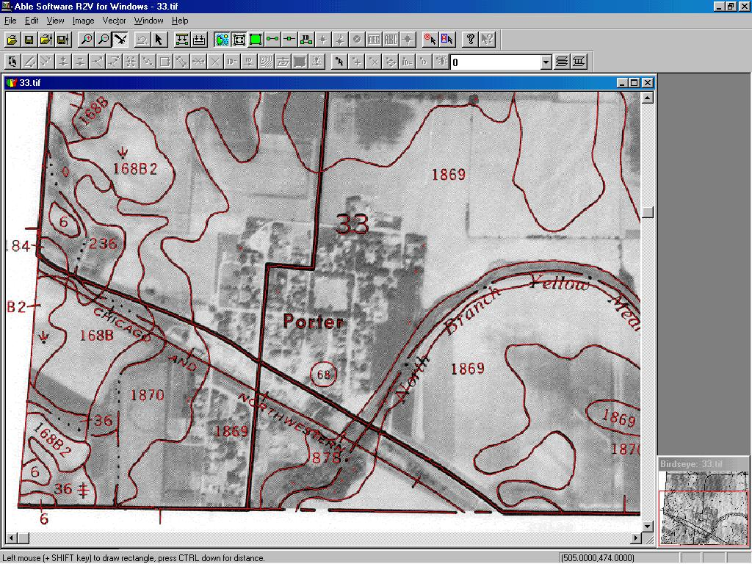
Rasterization: Convert Vector to Raster
Vectorization and digitizing convert every pile of paper, documents and maps into a well-structured and classified geographic information system (GIS) and its databases.

Slide 8
Selecting a Digitizing Technique
Complex images are better manually digitize and simpl images are better automatically digitize.
Choice depends on
Quality
Complexity
Contents of the Input Document
Optimal Choice: Combination of methods.

Slide 9
Obtaining Spatial Data Elsewhere
Free Share Data
Quality data is commercially available
Clearinghouses and Web portals
  SDI data clearinghouses
Metadata: Background Information that describes all necessary information about the data itself
It includes:
Identification Information: Data Source, time of acquisition
Data Quality Information: Positional, attribute and temporal accuracy, lineage etc.
Entity and attribute information: Related attribute, units of measures etc.
Data Formats and Standards: agreed upon way of representing data in a system.
ISO (International Organization for Standardization)
OGC (Open Geospatial Consortium)

Slide 10
DATA QUALITY
Not all geospatial data are created equally.
Data quality refers to the ability of a given dataset to satisfy the objective for which it was created.
With the voluminous amounts of geospatial data being created and served to the cartographic community, care must be taken by individual geographic information system (GIS) users to ensure that the data employed for their project is suitable for the task at hand.
Two primary attributes characterize data quality. Accuracy describes how close a measurement is to its actual value and is often expressed as a probability (e.g., 80 percent of all points are within +/− 5 meters of their true locations).
Precision refers to the variance of a value when repeated measurements are taken. A watch may be correct to 1/1000th of a second (precise) but may be 30 minutes slow (not accurate).

Slide 11
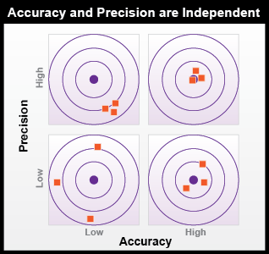
DATA QUALITY
Issues related to Data Quality
Positional
Temporal
Attribute
Lineage
Completeness
Logical consistency

Slide 12
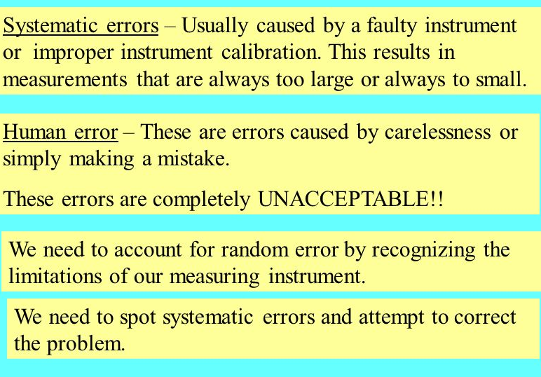
PHOTOGRAMMETRIC ERRORS
Human Errors in measurement
Instrumental or Systematic errors
Random Errors

Slide 13
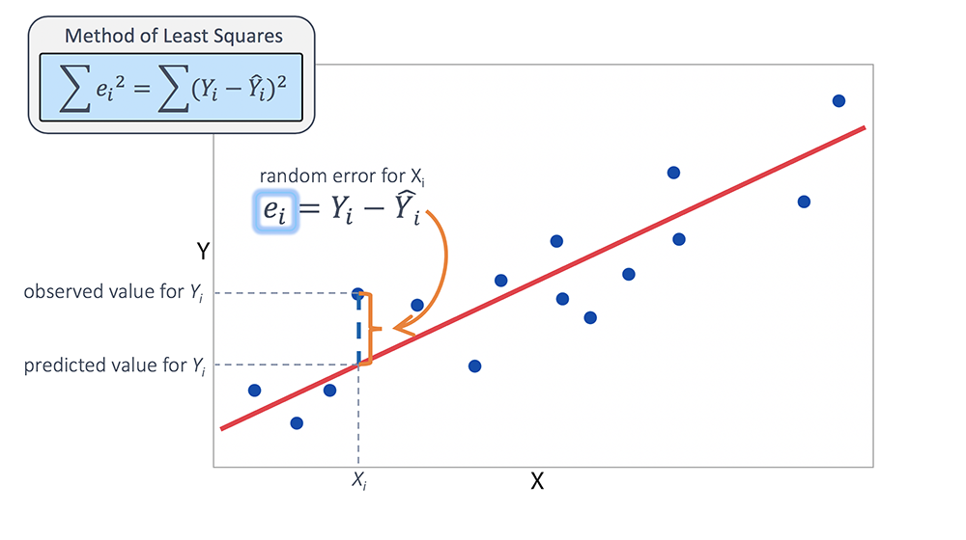
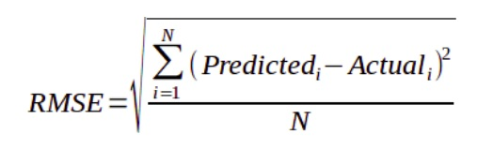
Root Mean Square(RMS) Error

Slide 14
Positional accuracy
Accuracy is the closeness of results of observations to the true values or values accepted as being true.
This implies that observations of most spatial phenomena are usually only considered to estimates of the true value.
The difference between observed and true (or accepted as being true) values indicates the accuracy of the observations.
Positional accuracy is the expected deviance in the geographic location of an object from its true ground position.
There are two components to positional accuracy. These are
relative and absolute accuracy.
Absolute accuracy concerns the accuracy of data elements with respect to a coordinate scheme, e.g. UTM.
Relative accuracy concerns the positioning of map features relative to one another.

Slide 15
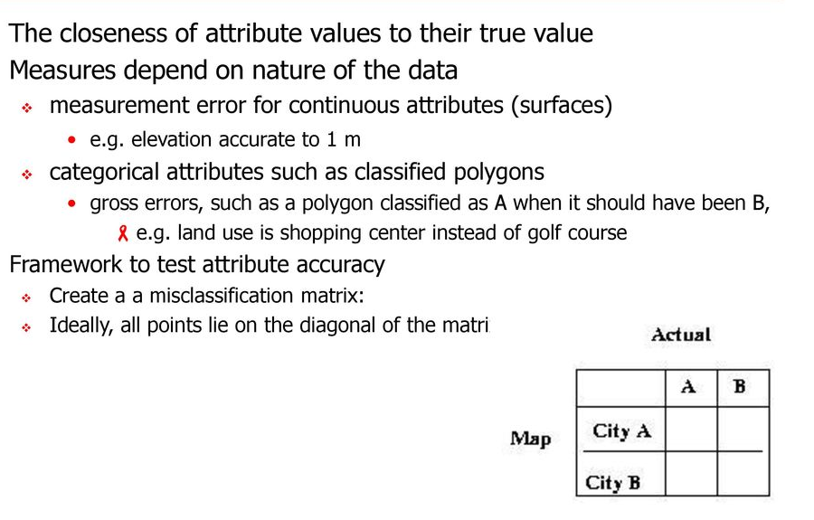
ATTRIBUTE ACCURACY
Attribute accuracy is equally as important as positional accuracy.
It also reflects estimates of the truth.
Interpreting and depicting boundaries and characteristics for forest stands or soil polygons can be exceedingly difficult and subjective.
Most resource specialists will attest to this fact. Accordingly, the degree of homogeneity found within such mapped boundaries is not nearly as high in reality as it would appear to be on most maps.

Slide 16
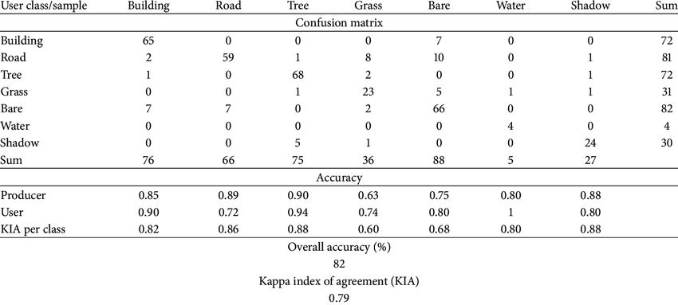
MISCLASSIFICATION/ CONFUSION MATRIX
Used to evaluate the accuracy of classification

Slide 17
Temporal accuracy
Temporal accuracy addresses the age or timeliness of a dataset.
No dataset is ever completely current.
In the time it takes to create the dataset, it has already become outdated.
Regardless, there are several dates to be aware of while using a dataset.
These dates should be found within the metadata. The publication date will tell you when the dataset was created and/or released.
The field date relates the date and time the data was collected.
If the dataset contains any future prediction, there should also be a forecast period and/or date.
To address temporal accuracy, many datasets undergo a regular data update regimen.
For example, the California Department of Fish and Game updates its sensitive species databases on a near monthly basis as new findings are continually being made. It is important to ensure that, as an end-user, you are constantly using the most up-to-date data for your GIS application.

Slide 18
Lineage
A record of the data sources and of the operations which created the database
how was it digitized,
from what documents?
for legal reasons the source of survey data is important
e.g. instruments, benchmarks used, name of surveyor, date

Slide 19
data completeness
Comprehensive inclusion of all features within the GIS database is required to ensure accurate mapping results.
Simply put, all the data must be present for a dataset to be accurate.
Are all of the counties in the state represented?
Are all of the stream segments included in the river network?
Is every convenience store listed in the database?
Are only certain types of convenience stores listed within the database?
Indeed, incomplete data will inevitably lead to incomplete or insufficient analysis.

Slide 20

logical consistency
Logical consistency requires that the data are topologically correct.
For example, does a stream segment of a line shapefile fall within the floodplain of the corresponding polygon shapefile?
Do roadways connect at nodes?
Do all the connections and flows point in the correct direction in a network?
For ex. the user was recently using a smartphone application to navigate a busy city roadway and was twice told to turn the wrong direction down one-way streets. So beware, errors in logical consistency may lead to traffic violations, or worse!

Slide 21
DATA PREPARATIONS
Preparing data for a digital geologic mapping project generally involves three steps:
  Preparing digital base map data (i.e. downloadable or previously stored thematic, topographic, or remotely sensed data, or data that you digitize, scan and geo-reference)
  Creating a database and/or individual files to store data that will be gathered in the field (e.g. the locations and descriptive attributes of rock units, rock unit contacts, and measured attitudes);
  Creating a map that is ready for editing in the field.

Slide 22
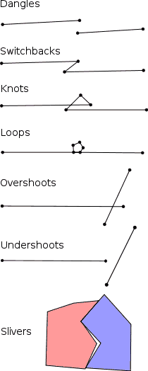
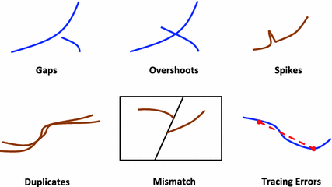
DATA CHECKS AND REPAIRS
Types:
  Origins of bad geometry
  Finding and fixing geometry problems
The Check Geometry tool will generate a report of all features with geometry problems within the feature classes provided. To fix the problems, use the Repair Geometry tool.

Slide 23
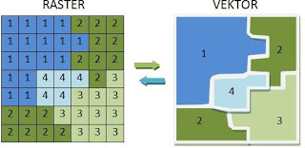
RASTERIZATION OR VECTORIZATION
Rasterization refers to converting vectors into rasters. While vectorization transforms rasters in vectors.
Rasterization: Convert Vector to Raster

Slide 24
TOPOLOGY GENERATION
Topology basically refers the relationship between things, and in the realm of GIS, Topology refers to the relationship between spatial features or objects. topology is important to GIS in (at least) three important way:
First, topology is necessary for certain spatial functions such as network routing through linear networks.
Second, topology can be used to create datasets with better quality control and greater data integrity. Topology rules can be created so that edits made to a dataset can be 'validated' and show errors in that dataset. An example would be the creation of a new manhole/sewer access feature outside a polygon dataset of road features.
Third, by creating topological relationships between feature classes, features can be shared across feature classes. In other words, if you open one dataset and edit/move a line feature that is shared between two feature classes, then both feature classes will be updated to reflect the edits. This is massively helpful for keeping datasets synchronized.

Slide 25
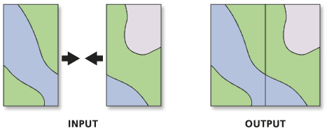
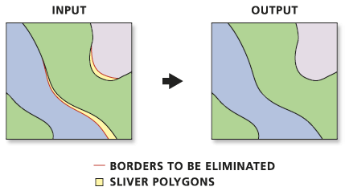
COMBINING DATA FROM MULTIPLE SOURCES
Multiple Datasets should be related to each other.
There are 4 fundamental cases to be considered:
They may be about same area, but differ in accuracy
They may be about same area, but differ in choice of representation,
They may be about adjacent areas, and have to be merged into a single data set.
They may be about same or adjacent areas, but referenced in different coordinate systems.

Slide 26
DIFFERENCES IN ACCURACY
Errors can be injected at many points in a GIS analysis, and one of the largest sources of error is the data collected.
  Varying levels of accuracy
  Resolution of acquired data
  Displaced features
  Small scales.
Accuracy in GIS is the degree to which information on a map matches real-world values.
It is an issue that pertains both to the quality of the data collected and the number of errors contained in a dataset or a map.

Slide 27
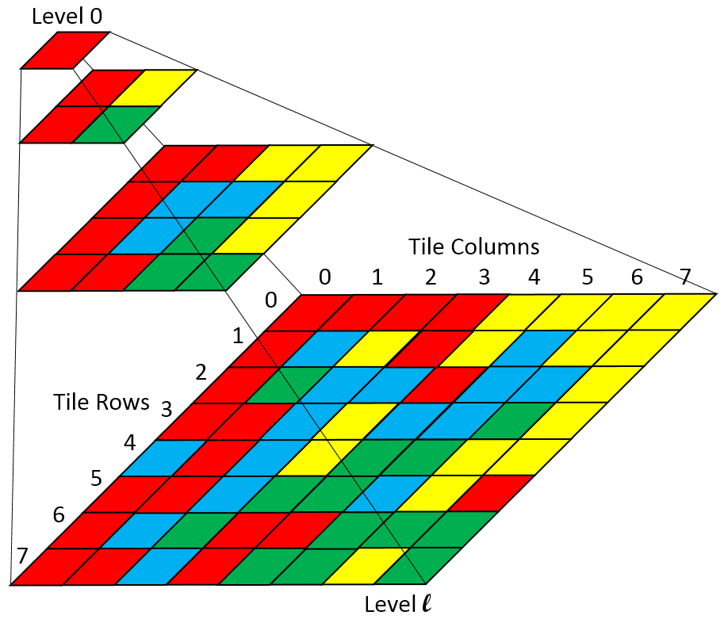
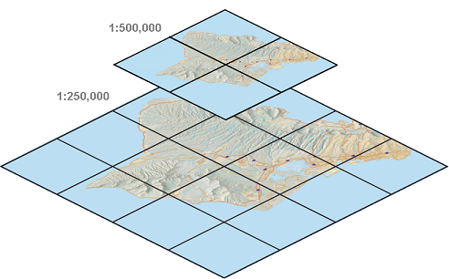
DIFFERENCES IN REPRESENTATION
refers to the level of measurement and exactness of description in a GIS database.

Slide 28
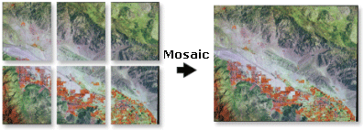
MERGING DATA SETS OF ADJACENT AREAS
Single seamless data set
Edge mapping
Smoothing and data cleanup functions are needed

Slide 29
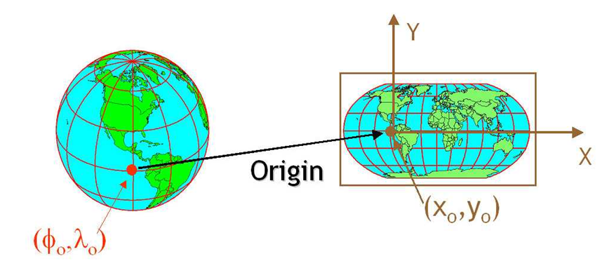
DIFFERENCES IN COORDINATE SYSTEMS
Map Projections
Coordinate transformations

Slide 30
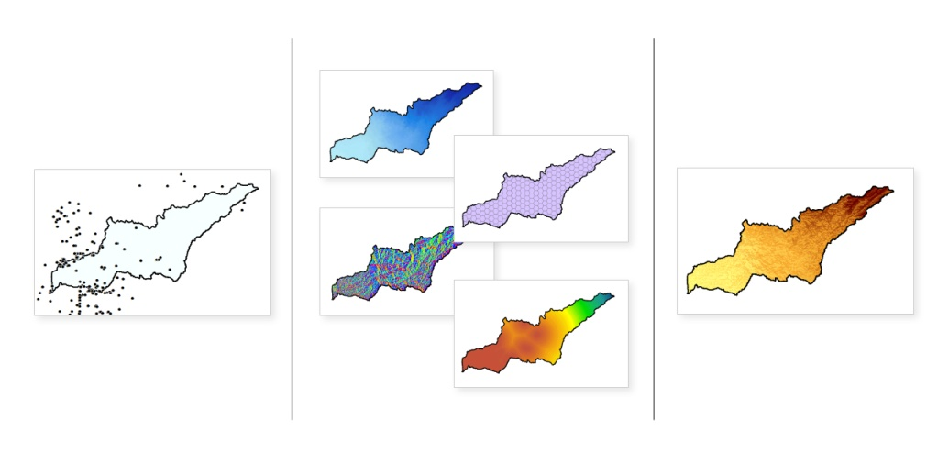
OTHER DATA PREPARATION FUNCTIONS
Format transformation functions
Graphic element editing
Coordinate thinning (remove redundant or excess vertices )

Slide 31
POINT DATA TRANSFORMATION: INTERPOLATION
Interpolation predicts values for cells in a raster from a limited number of sample data points.
It can be used to predict unknown values for any geographic point data, such as elevation, rainfall, chemical concentrations, noise levels, and so on.
IDW
The IDW (Inverse Distance Weighted) tool uses a method of interpolation that estimates cell values by averaging the values of sample data points in the neighborhood of each processing cell.
The closer a point is to the center of the cell being estimated, the more influence, or weight, it has in the averaging process.

Slide 32
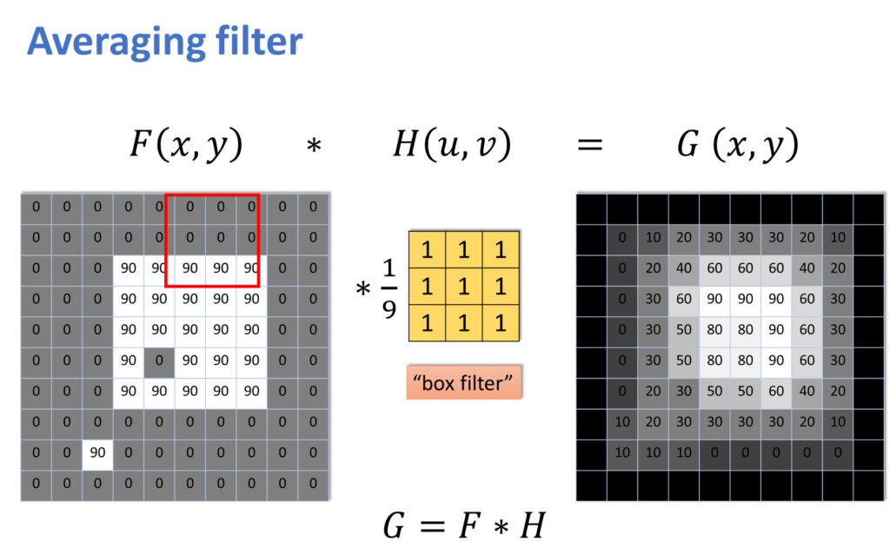
IDW

Slide 33
POINT DATA TRANSFORMATION: INTERPOLATION
Interpolation predicts values for cells in a raster from a limited number of sample data points.
It can be used to predict unknown values for any geographic point data, such as elevation, rainfall, chemical concentrations, noise levels, and so on.
Kriging
Kriging is an advanced geostatistical procedure that generates an estimated surface from a scattered set of points with z-values.
More so than other interpolation methods, a thorough investigation of the spatial behavior of the phenomenon represented by the z-values should be done before you select the best estimation method for generating the output surface.

Slide 34
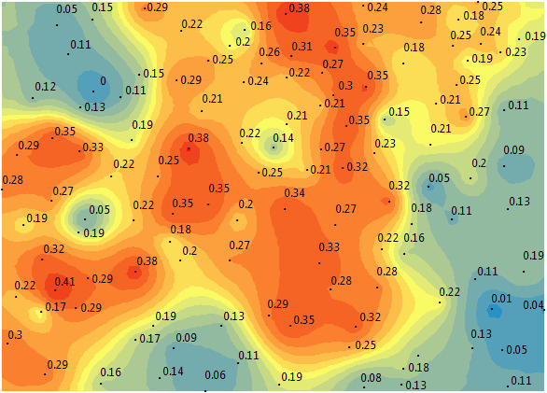
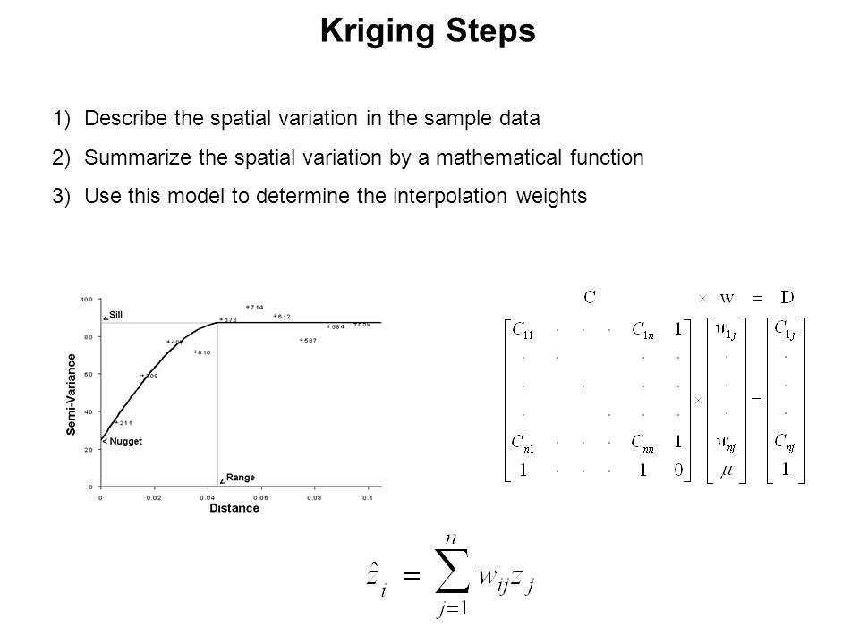
Kriging

Slide 35
POINT DATA TRANSFORMATION: INTERPOLATION
Interpolation predicts values for cells in a raster from a limited number of sample data points.
It can be used to predict unknown values for any geographic point data, such as elevation, rainfall, chemical concentrations, noise levels, and so on.
Natural neighbour
Natural Neighbor interpolation finds the closest subset of input samples to a query point and applies weights to them based on proportionate areas to interpolate a value (Sibson, 1981).
It is also known as Sibson or "area-stealing" interpolation.

Slide 36
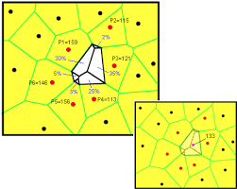
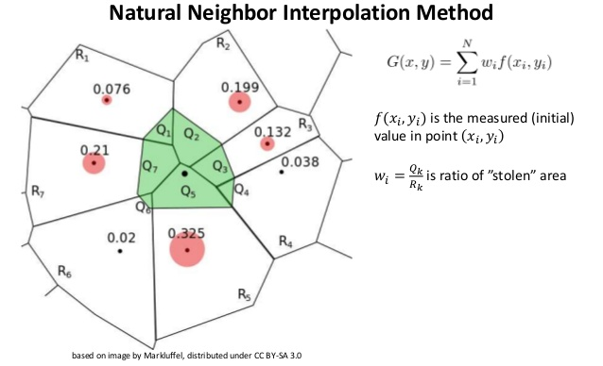

Slide 37
POINT DATA TRANSFORMATION: INTERPOLATION
Interpolation predicts values for cells in a raster from a limited number of sample data points.
It can be used to predict unknown values for any geographic point data, such as elevation, rainfall, chemical concentrations, noise levels, and so on.
Trend Surface Fitting
Trend is a global polynomial interpolation that fits a smooth surface defined by a mathematical function (a polynomial) to the input sample points.
The trend surface changes gradually and captures coarse-scale patterns in the data.

Slide 38
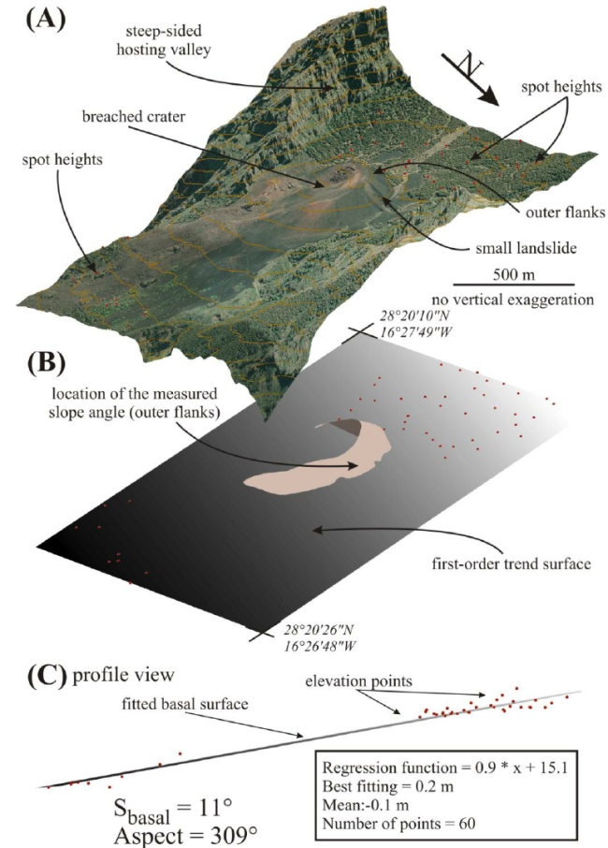
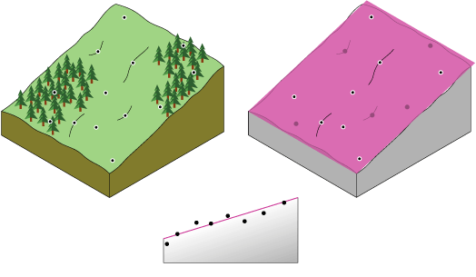

Slide 39
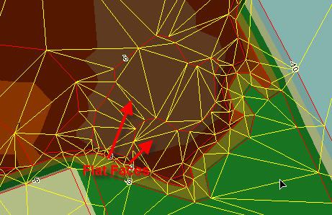
Triangulation
The Delaunay triangulation ensures that no vertex lies within the interior of any of the circum-circles of the triangles in the network.
If the Delaunay criterion is satisfied everywhere on the TIN, the minimum interior angle of all triangles is maximized.

Slide 40

Slide Show Tips
https://saylordotorg.github.io/text_essentials-of-geographic-information-systems/s09-04-data-quality.html
http://planet.botany.uwc.ac.za/nisl/GIS/GIS_primer/page_08.htm

Slide 41
Widescreen Test Pattern (16:9)
Aspect Ratio Test
(Should appear circular)
4x3
16x9

